Slide 1

Variables and
Assignments
By: Mir Faraz Ali
programming Fundamentals

Slide 2
Variables
Variables are containers for storing data values.
In C++, there are different types of variables (defined with different keywords).
For example:
  int - stores integers (whole numbers), without decimals, such as 123 or -123
  double - stores floating point numbers, with decimals, such as 19.99 or -19.99
  char - stores single characters, such as 'a' or 'B'. Char values are surrounded by single quotes
  string - stores text, such as "Hello World". String values are surrounded by double quotes
  bool - stores values with two states: true or false

Slide 3
Variable Declarations
& Identifiers
  Identifiers:
  Declaring (Creating) Variables
  All C++ variables must be identified with unique names.
  These unique names are called identifiers.
  Identifiers can be short names (like x and y) or more descriptive names (age, sum, totalVolume).
Syntax:
Datatype variableName = value;
Where Datatype is one of C++ types (such as int), and variableName is the name of the variable (such as x or myName). The equal sign is used to assign values to the variable.

Slide 4
Examples:
  Create a variable called myNum of type int and assign it the value 15:
  int myNum = 15;
  cout << myNum;
  You can also declare a variable without assigning the value, and assign the value later:
  int myNum;
  myNum = 15;
  cout << myNum;

Slide 5
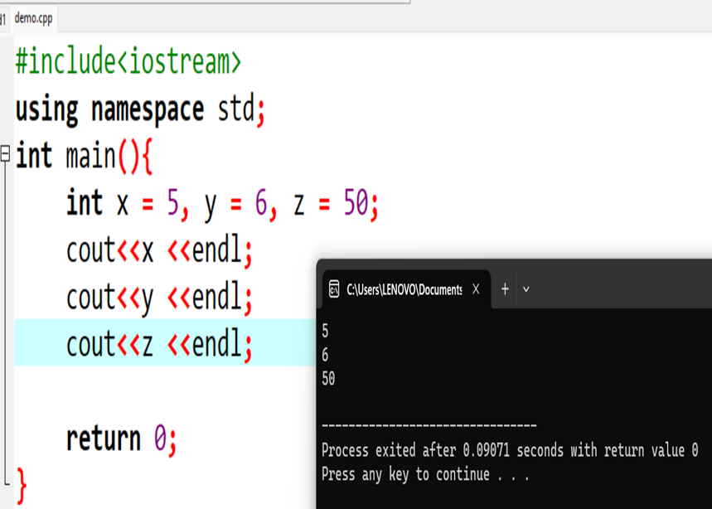
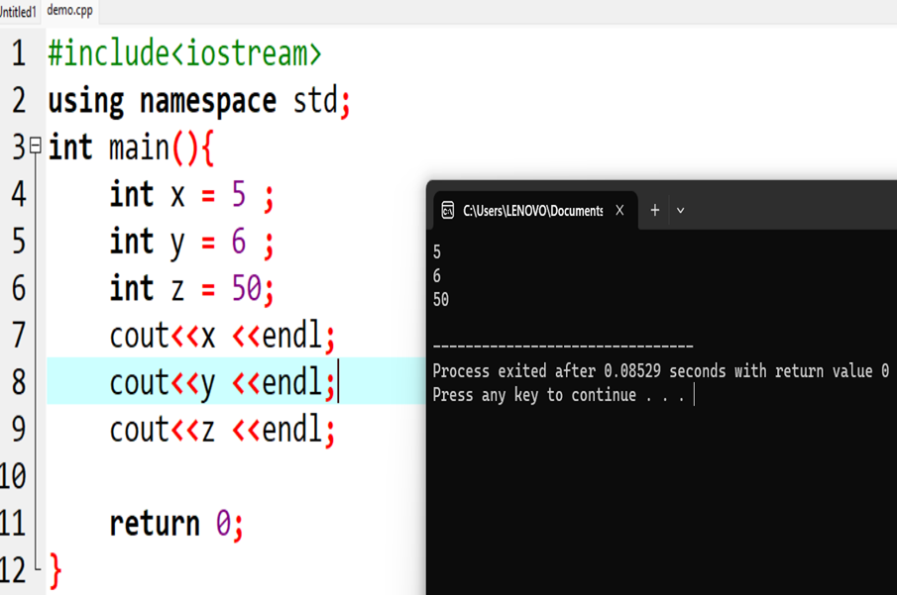
Declare Many Variables:
  To declare more than one variable of the same type, use a comma-separated list:

Slide 6
Real Life Example:
// Student data
int studentID = 15;
int studentAge = 23;
float studentFee = 75.25;
char studentGrade = 'B';
// Print variables
cout << "Student ID: " << studentID << "\n";
cout << "Student Age: " << studentAge << "\n";
cout << "Student Fee: " << studentFee << "\n";
cout << "Student Grade: " << studentGrade << "\n";

Slide 7
C++ Output:
  The cout object, together with the
  << operator, is used to output values and print text.
  Just remember to surround the text with double quotes (""):
      #include <iostream>
      using namespace std;
      int main() {
      cout << "Hello World!";
      return 0;
      }
  You can add as many cout objects as you want. However, note that it does not insert a new line at the end of the output:
          #include <iostream>
          using namespace std;
          int main() {
          cout << "Hello World!";
          cout << "I am learning C++";
          return 0;
          }

Slide 8
C++ User Input:
Example:
  You have already learned that cout is used to output (print) values. Now we will use cin to get user input.
  cin is a predefined variable that reads data from the keyboard with the extraction operator (>>).
  In the following example, the user can input a number, which is stored in the variable x. Then we print the value of x:
  int x;
  cout << "Type a number: ";
  cin >> x;
  cout << "Your number is: " << x;

Slide 9

End Of Class

